Slide 1

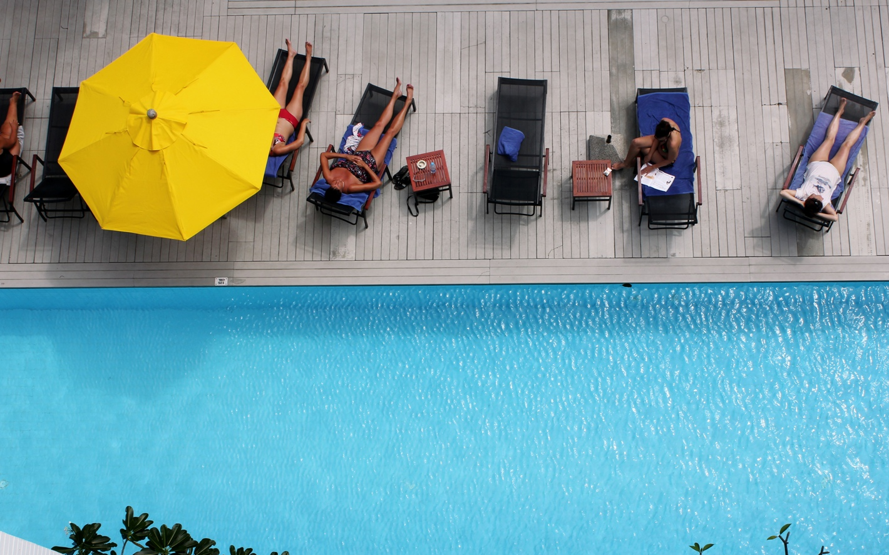
COLLEGE FASHION
“ An exclusive resort built in contemporary Sino Portuguese architecture and design”

Slide 2






Superb
location
Stylish
hotel
Variety of
Room type
Luxury
service
Enjoy
Recreation
Friendly
environment

Slide 3
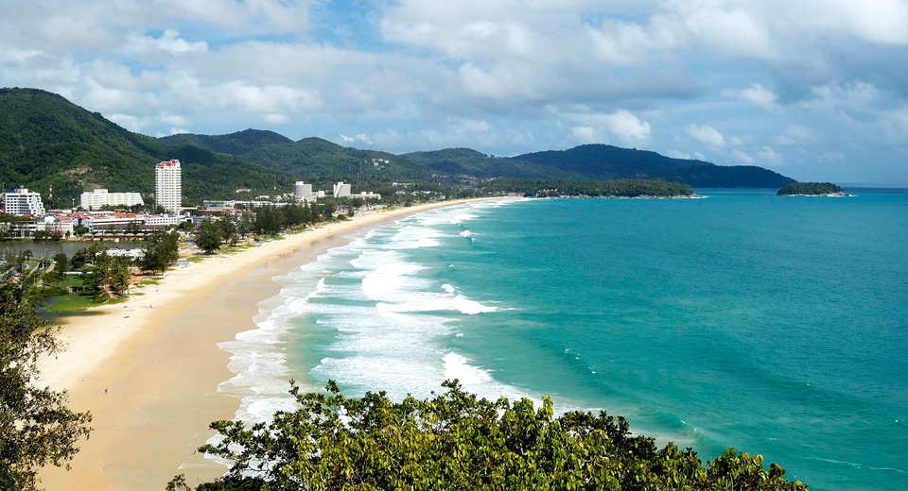

SUPERB LOCATION
We are here!!

Slide 4
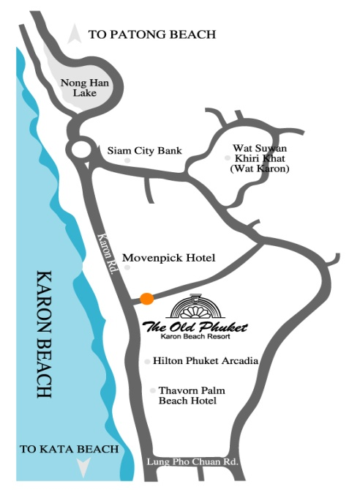
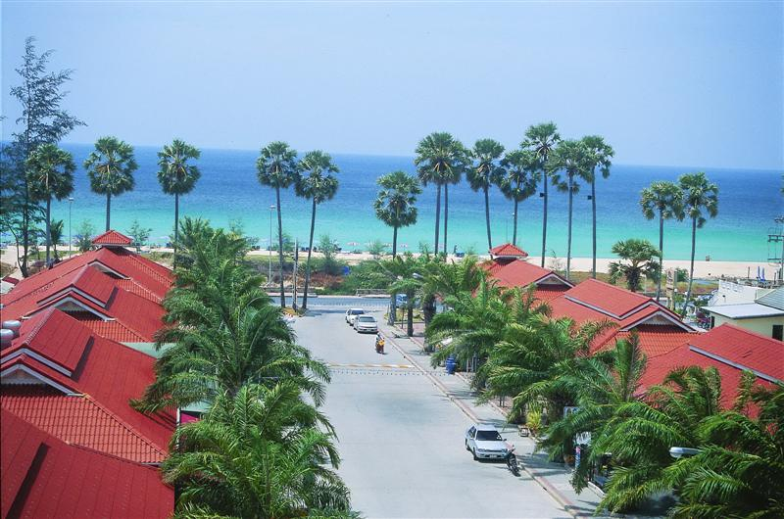
SUPERB LOCATION
2 minutes to Karon Beach
15 minutes to Patong Beach
30 minutes to Phuket Town
50 minutes to Phuket International Airport

Slide 5

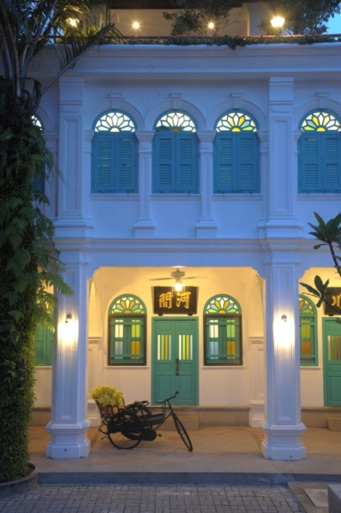
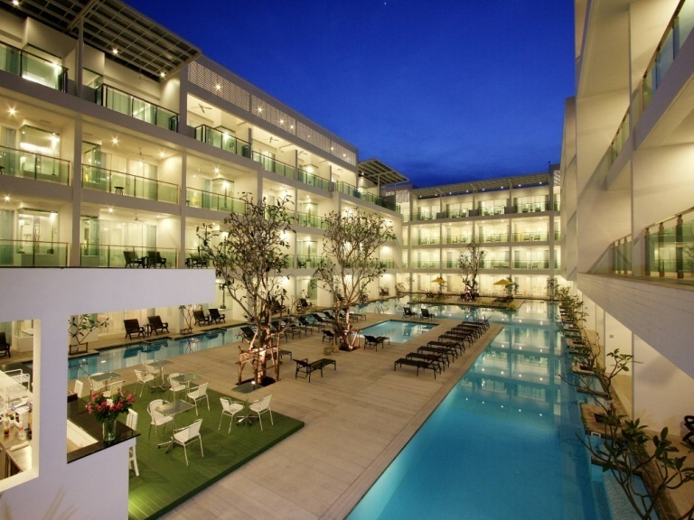
STYLISH HOTEL
The Old Phuket – Karon Beach Resort has combined 2 different styles in the resort area as Sino Wing & Serene Wing.
88 rooms at Sino Wing and
96 rooms at Serene Wing
The 184 rooms comprises with:
Notes:
Total one hundred eighty four room
- Eighty eighty rooms in the Sino wing
- Ninety six room in the Serene wing

Slide 6
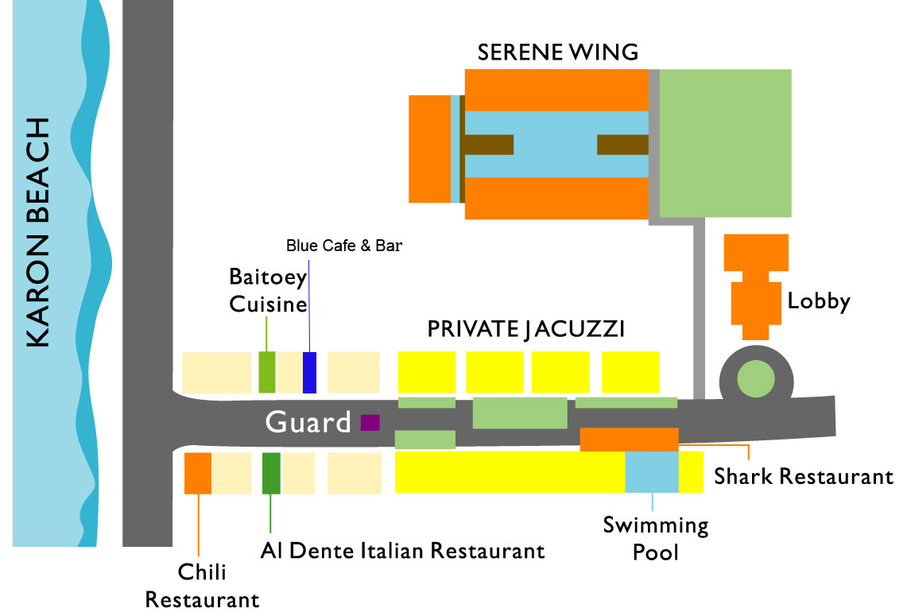
STYLISH HOTEL
Notes:
Total one hundred eighty four room
- Eighty eighty rooms in the Sino wing
- Ninety six room in the Serene wing

Slide 7

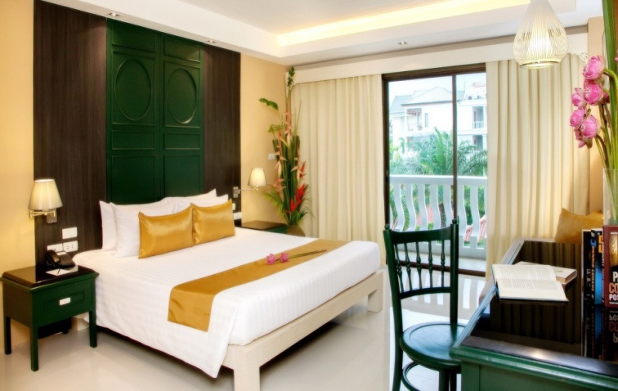
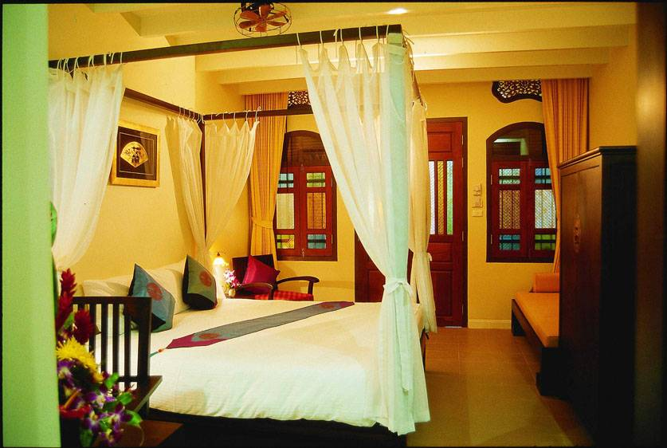
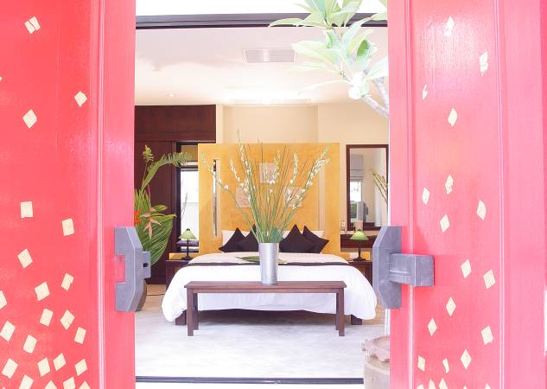
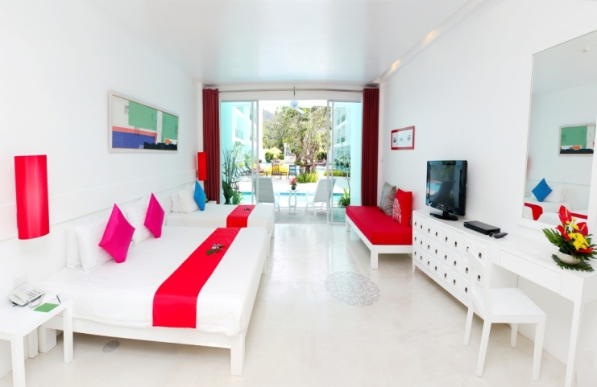
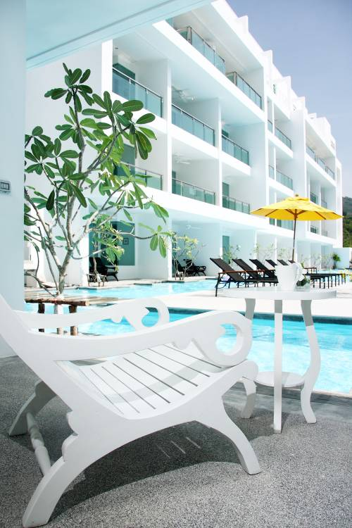
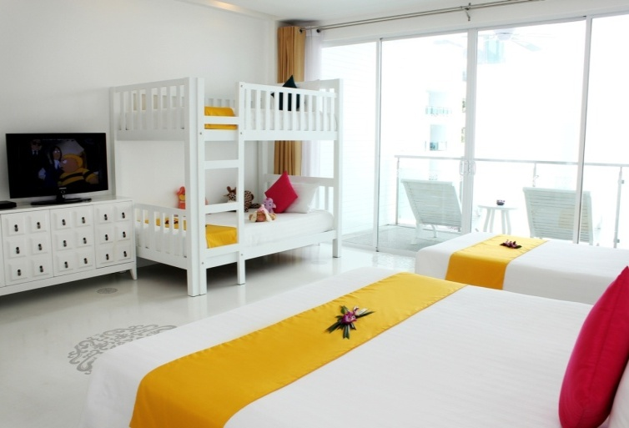
A VARIETY OF ROOM TYPE
Guests can choose the room that they prefer and suit for their satisfaction.

Slide 8

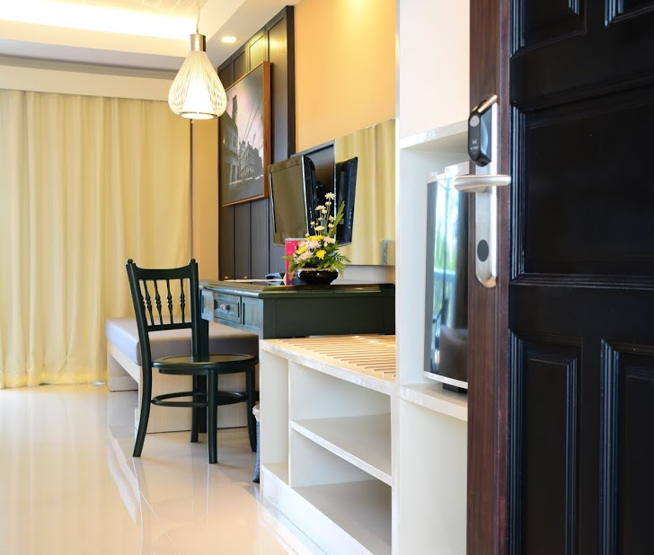
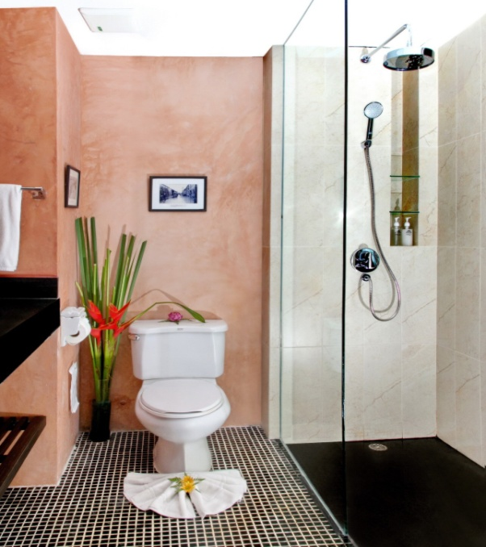
88 at Sino Wing
rooms
56 Sino Deluxe Rooms
- 22 Twin
- 34 Double
Notes:
Terrace deluxe – highlight of Sino wing
Design to look like Phuket shop house with bathtub and outdoor rain shower
This room is very unique and boutique design, you cannot find this design in other hotel.
Good for honeymooner or guest who like a boutique design room

Slide 9
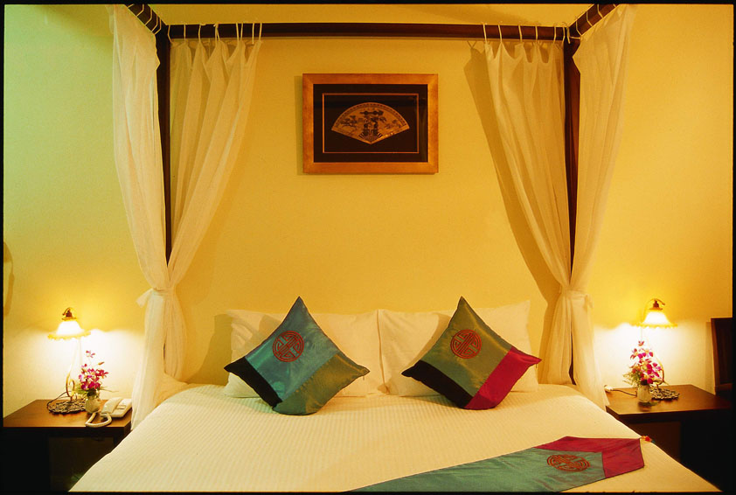
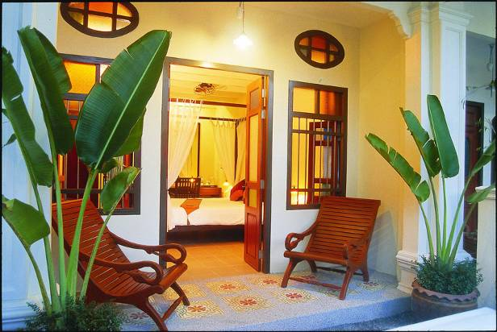
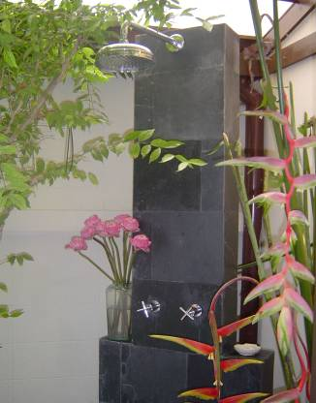
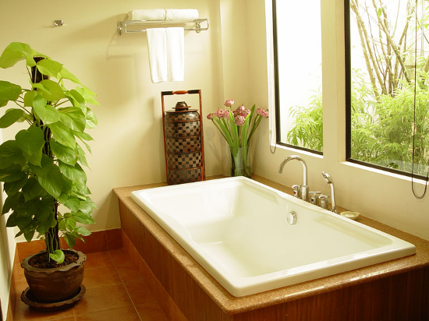
88 at Sino Wing
rooms
15
Terrace
Deluxe
Rooms
Notes:
Terrace deluxe – highlight of Sino wing
Design to look like Phuket shop house with bathtub and outdoor rain shower
This room is very unique and boutique design, you cannot find this design in other hotel.
Good for honeymooner or guest who like a boutique design room

Slide 10
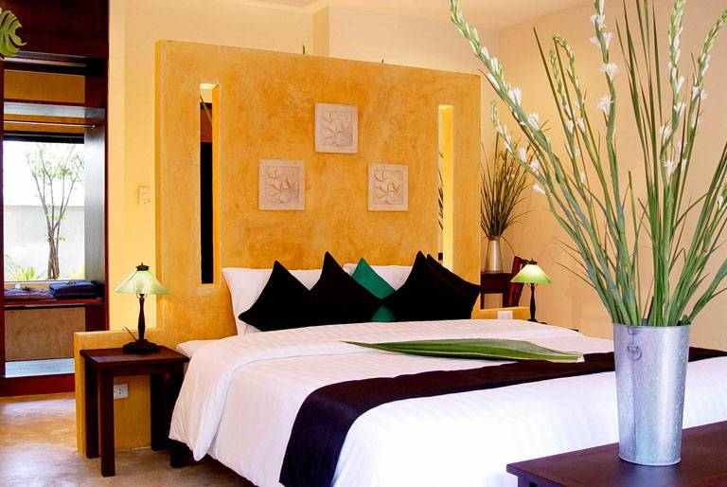
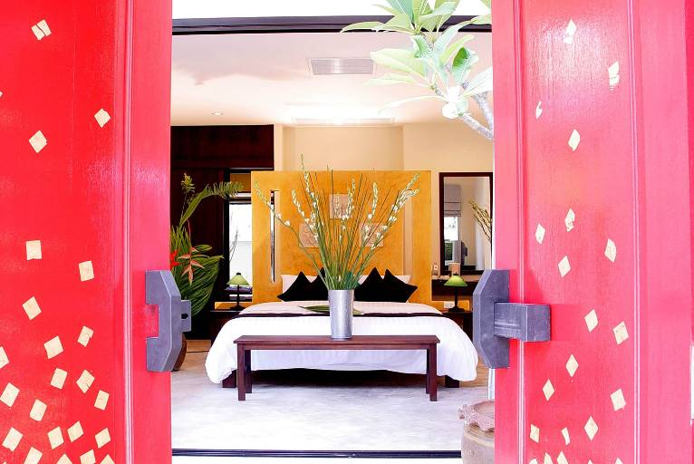
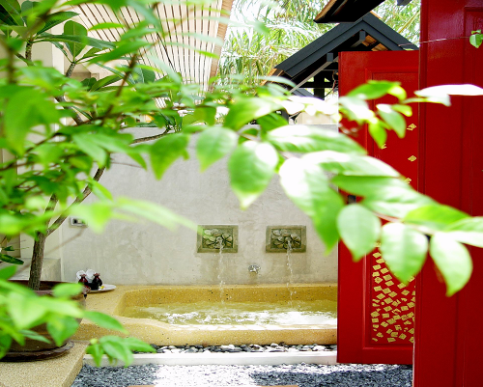
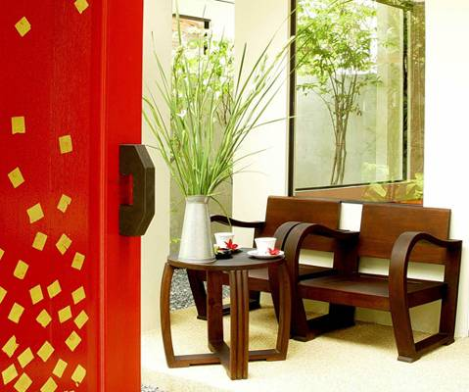
88 at Sino Wing
rooms
17 Private Jacuzzi Rooms
Notes:
Private jacuzzi room
Another boutique designed room, one-storey building room with outdoor jacuzzi tub and outdoor rain shower
There three room types are very boutique and unique design which cannot find from other hotel. If you for a modern design, here is our Serene wing

Slide 11
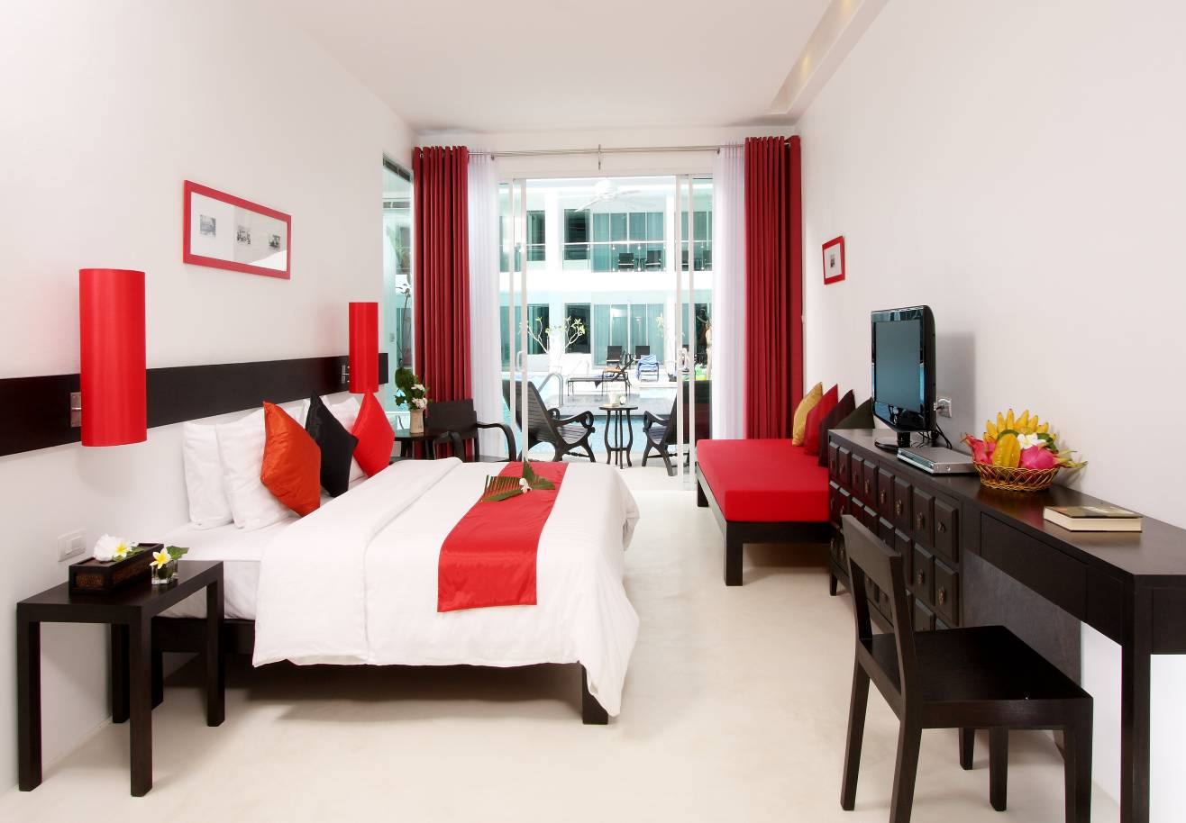
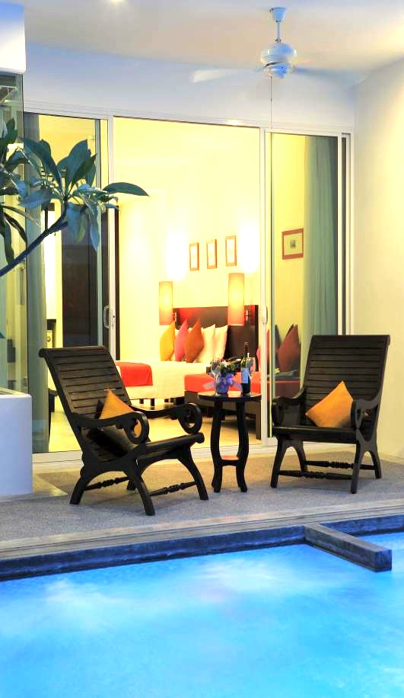
96 at Serene Wing
rooms
24 Deluxe Pool Access Rooms
68 Deluxe Pool View Rooms
Notes:
This room design for family of 2+2 with one king size bed one single bed and one sofa bed. Choice for pool view and access.

Slide 12

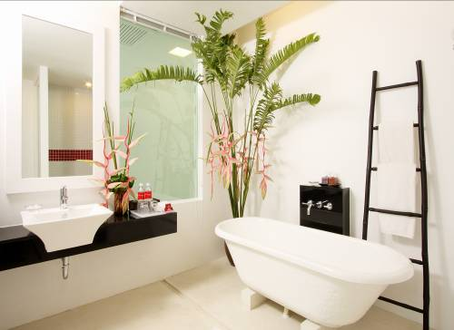
96 at Serene Wing
rooms
24 Deluxe Pool Access Rooms
68 Deluxe Pool View Rooms
Notes:
This room design for family of 2+2 with one king size bed one single bed and one sofa bed. Choice for pool view and access.

Slide 13
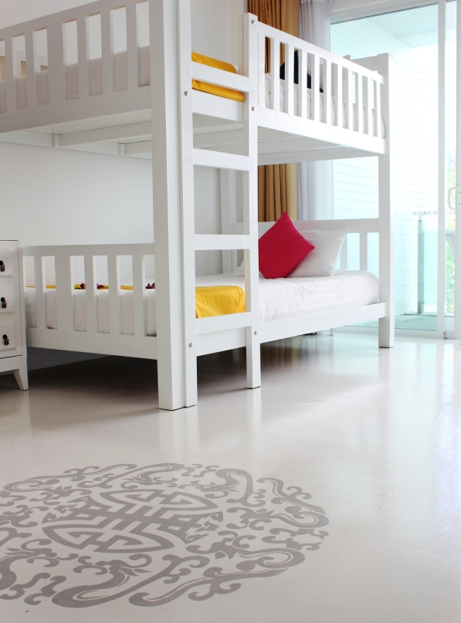

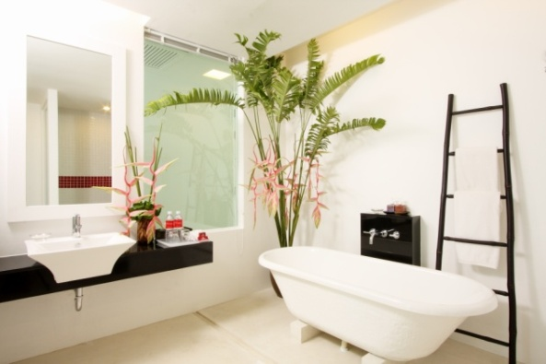
96 at Serene Wing
rooms
Deluxe Family Rooms
24 rooms for 2Adults + 2 Children
4 rooms for 2Adults + 3 Children
(1King + 1Single + 1Bunk Bed)
Notes:
Deluxe Family room, one king size bed one single and one bunk bed fit for 2 adults and 3 children.

Slide 14

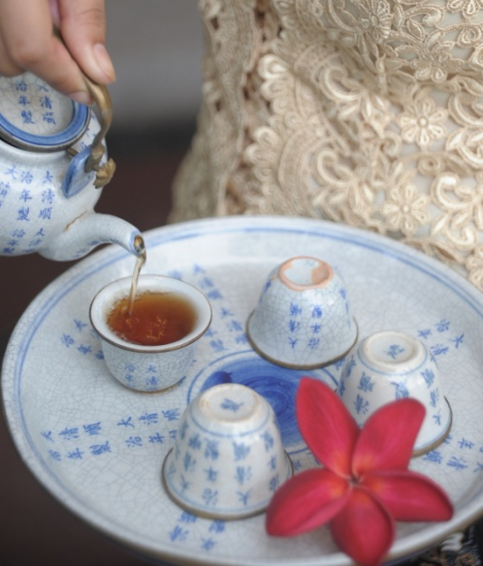
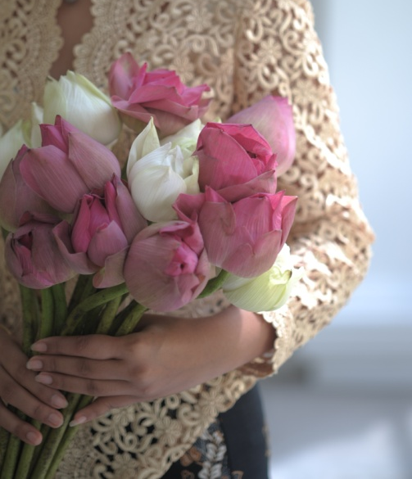
LUXURY SERVICE
Free wi-fi
24hrs. Reception
Room Service
Tour desk & Car Rental
Baby Sitting
Currency Exchange
ATM Machine
Doctor on call
Luggage Porter
Laundry & Dry Cleaning
“The friendliness and professional is a heart
of our standard services. ”

Slide 15
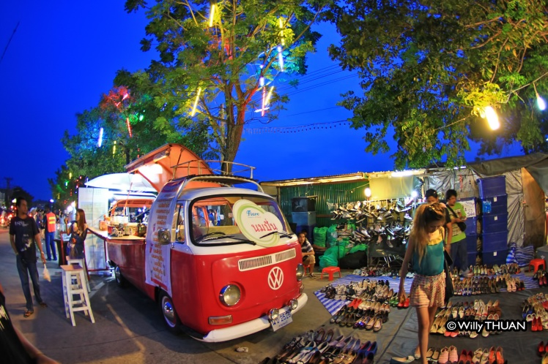

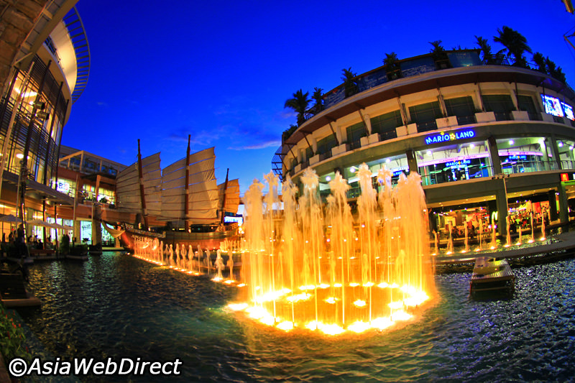
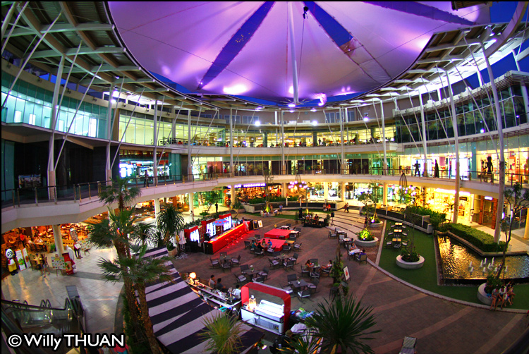
LUXURY SERVICE
Shuttle bus (as per hotel schedule) :
- Jungceylon, Patong Beach
- Central Festival, Phuket Town
- Weekend Market
WEEKEND MARKET
JUNGCEYLON
CENTRAL FESTIVAL

Slide 16
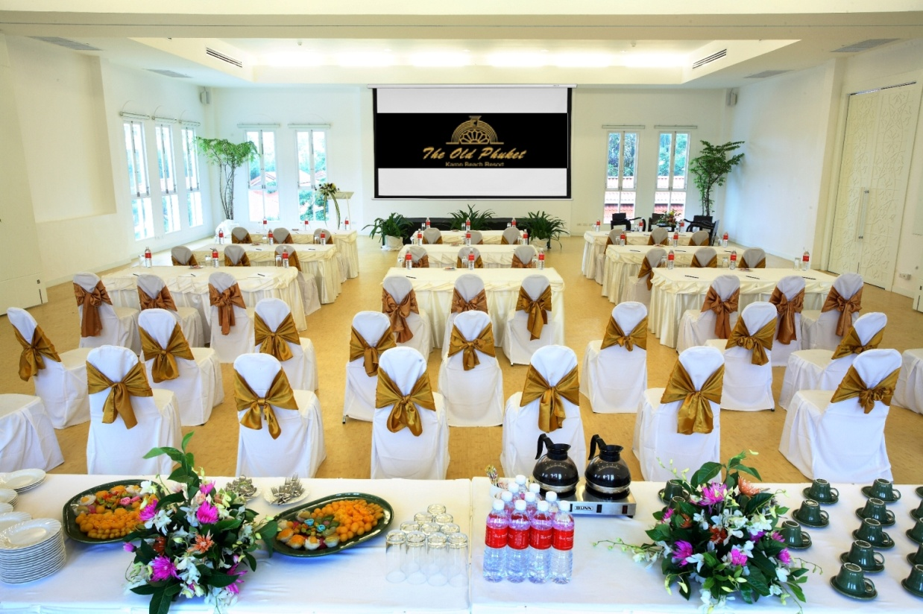
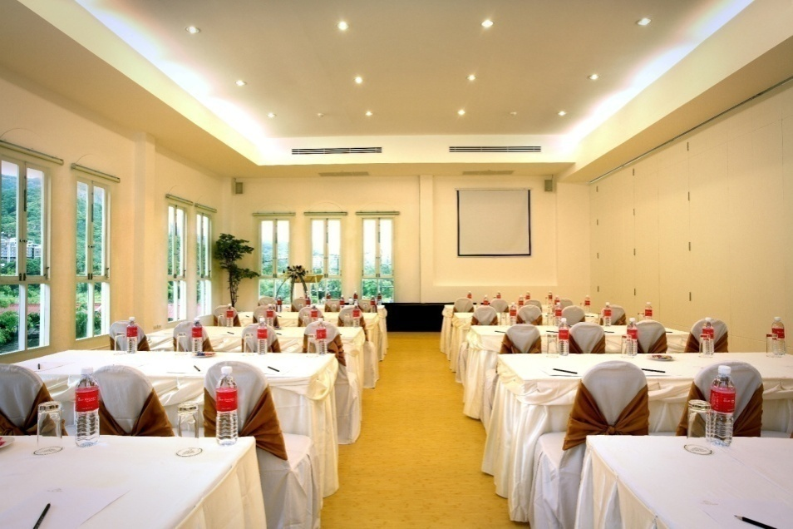
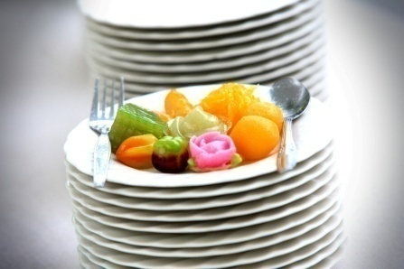

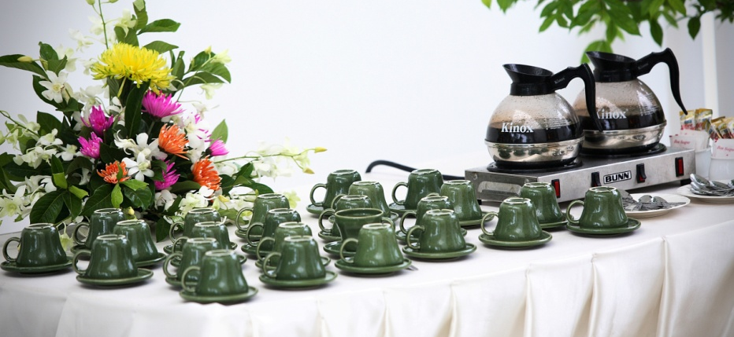
LUXURY SERVICE
MEETING ROOM
SIZE: 120 Square Meter
HEIGHT: 3.5 Meter
CAPACITY:
- Theater 60 Seats
- Class Room 40 Seats
- U – Shape 20 Seats

Slide 17
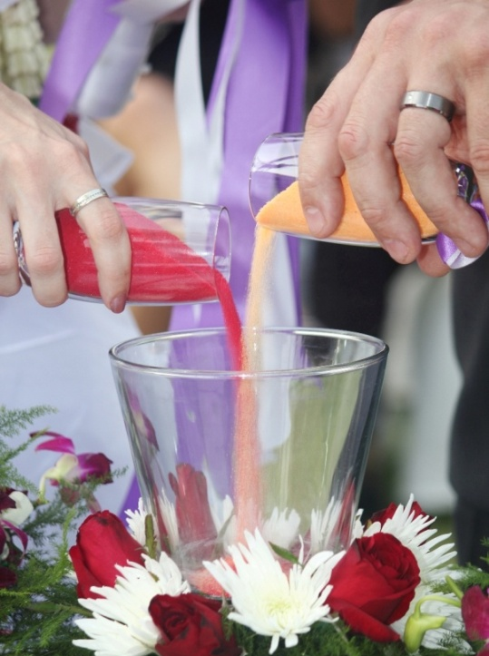
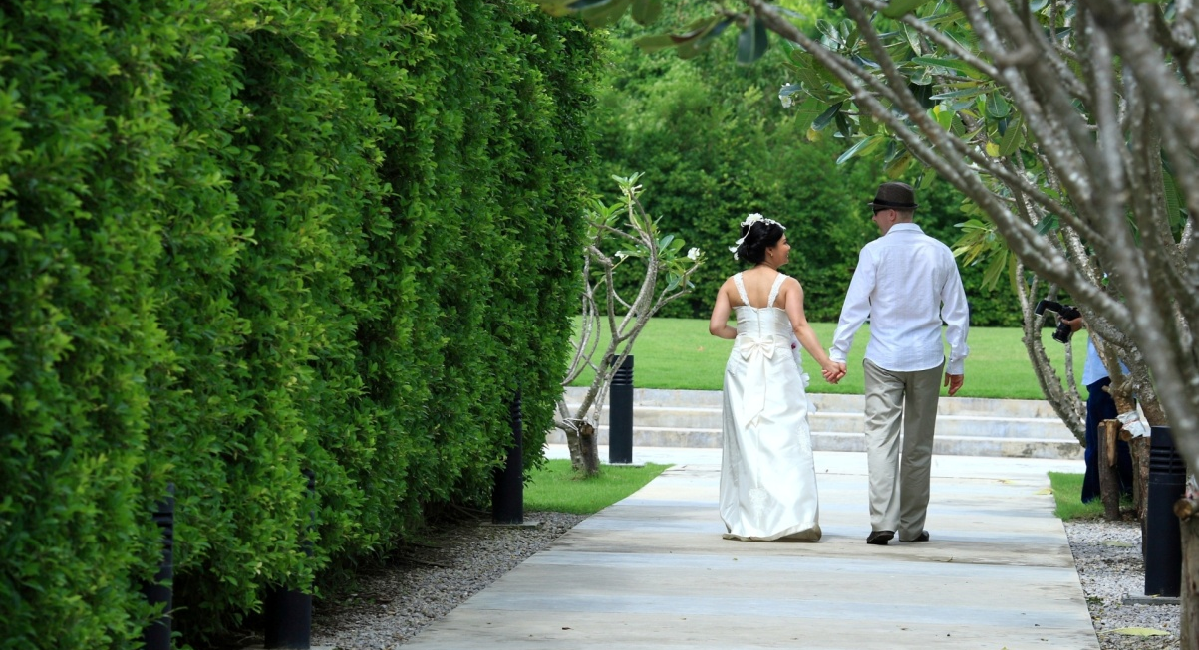
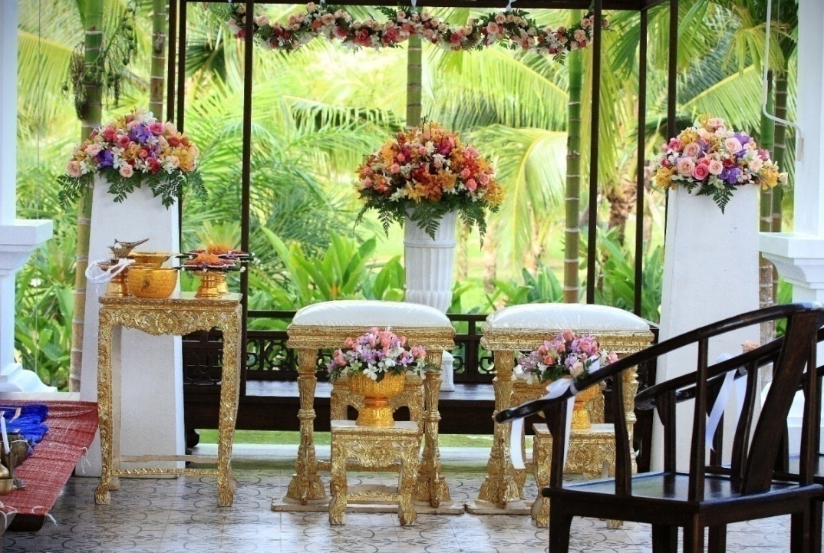
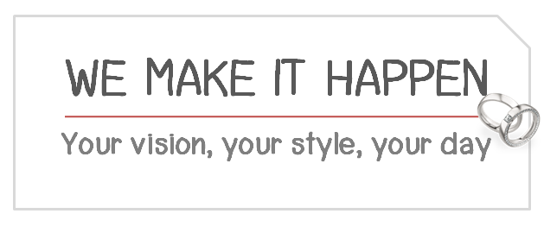
LUXURY SERVICE

Slide 18
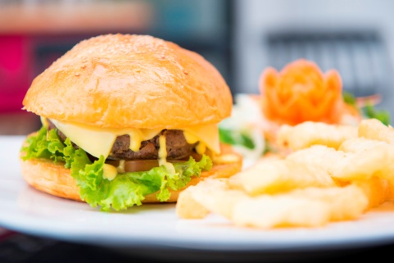

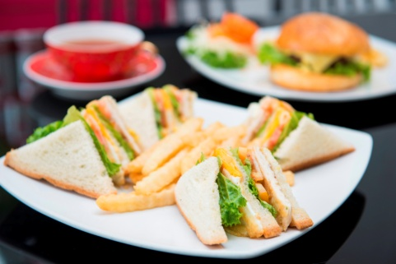
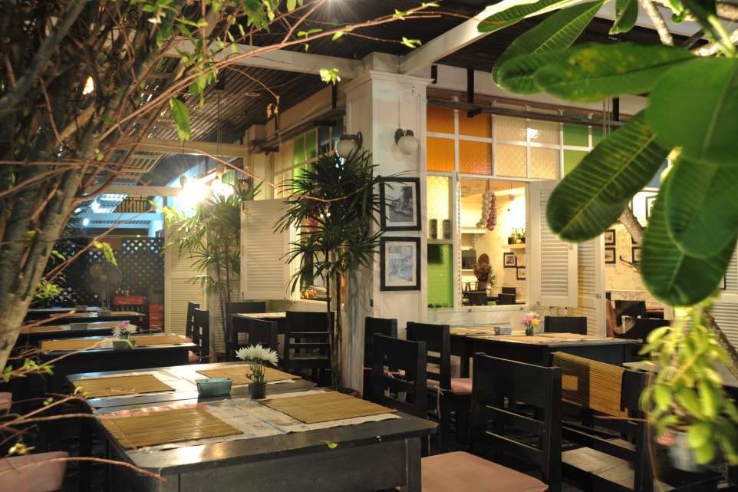
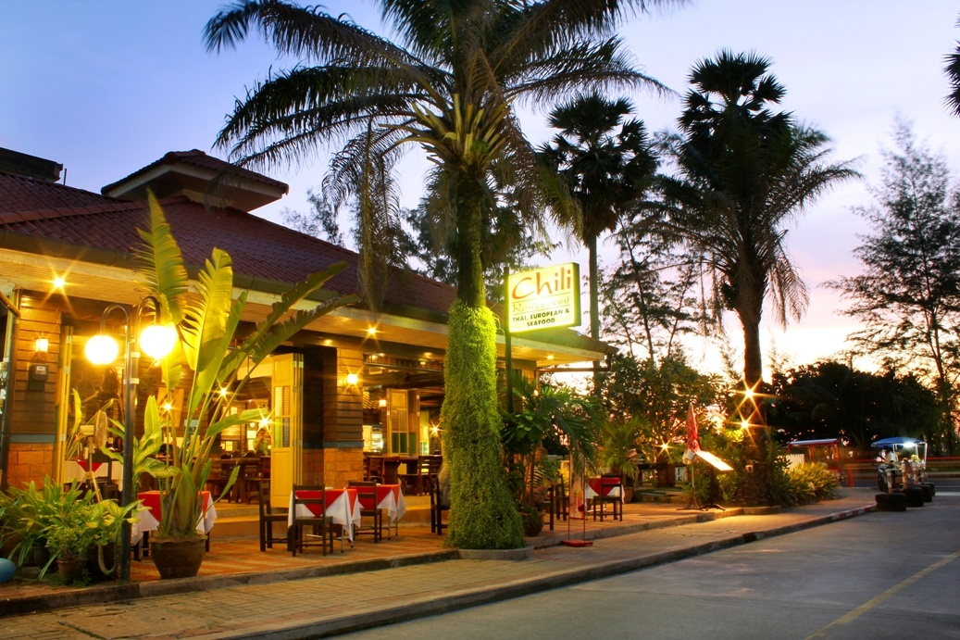
Restaurant & Bars
SHARK RESTAURANT - Serving daily breakfast
CHILI RESTAURANT - Sea side restaurant serving International and Seafood
BAI TOEY - Serving daily Thai Cuisine a la cart
AL DENTE - Serving daily Italian’s cuisine

Slide 19

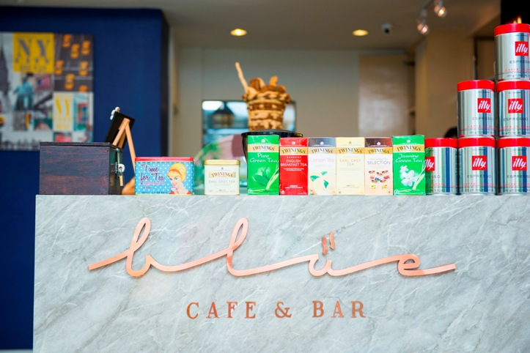
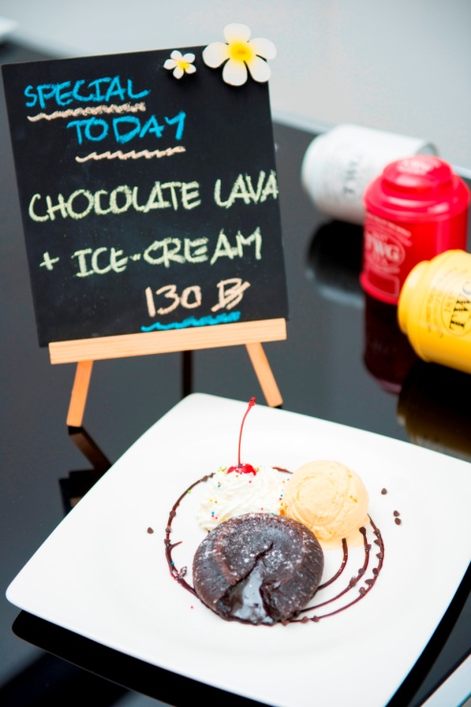
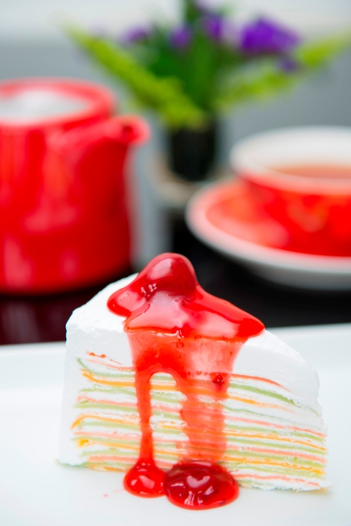
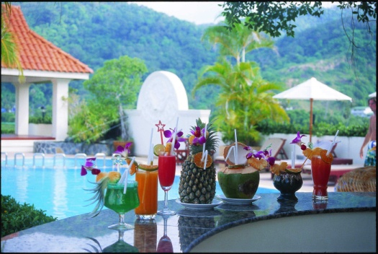
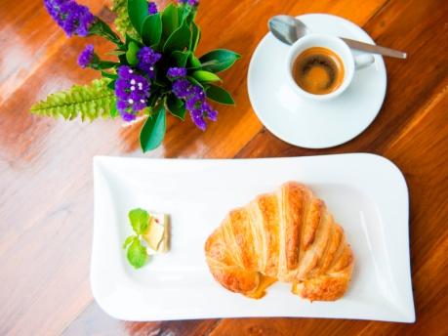
Restaurant & Bars
Restaurant & Bars
LOBBY CORNER
KO-I POOL BAR
Located on 3rd floor of SINO WING
THE POOL BAR
Located at Serene Wing
Blue Café & Bar
Notes:
Four main restaurants
Shark restaurant for breakfast
Chili Restaurant serve international food with live music
Baitoey Thai Cuisine – serving Thai menu
Al Dente – serve Italain menu

Slide 20





ENJOY RECREATION
SINO POOL
SERENE POOL
SINO POOL
SERENE POOL

Slide 21


ENJOY RECREATION
“Guests of all ages can enjoy a
variety of activities at the hotel”
Fitness Center
Table Tennis
Mini Putting Golf
Yoga

Slide 22




ENJOY RECREATION
Tak Bat
(offer food to the monk)
Thai Cooking Class
Carving Class
Candle Light Dinner

Slide 23




ENJOY RECREATION
Clay Figure Making
Dolls Painting
Balloon Painting
Craft Making
Paper Folding
Balloon Making

Slide 24



FRIENDLY ENVIRONMENT
Friendly environment guarantee by environmental awards, our resort is located among the green environment and the structures are built in the collocated landscape. A green area with a lot of trees will be preserved as much as we can.

Slide 25







CORPORATE SOCIAL RESPONSIBILITY
Donate to Charity for Children
Giving
scholarships
Blood donation
Electronic donation
Beach clean up

Slide 26

“We look forward to welcoming you and your guests to
The Old Phuket – Karon Beach Resort”

